Slide 1
1115 Substance Use Disorder (SUD) System Reform Demonstration: PROVIDER TRAINING
Utilizing the Create a Case Wizard
Portal Submission Requirements

Slide 2
SUBMISSION REQUIREMENTS
PART 1 | 08/01/2023

Slide 3
OBJECTIVES
Utilization Management (UM) Workflow
Required Documentation
Provider Portal Assistance

Slide 4
MN SUD 1115 Acentra Health Proposed Post Payment Review Workflow

Slide 5
REQUIRED DOCUMENTATION
Withdrawal Management
Comprehensive Assessment (completed within 72 hours of Admission) or Biopsychosocial Screening Assessment
Comprehensive Assessment Summary
Initial Stabilization Plan with measurable goals
Progress Notes (if not integrated in the treatment plan review)
Physician Exam completed by a MD, APRN, PA.
CIWA/COWS or similar withdrawal scale
Medication Administration Record (MAR)
Documentation of Treatment Coordination (should be in ITP or Progress notes)
Discharge or Transition Summary identifying level of care client is moving to

Slide 6
REQUIRED DOCUMENTATION
Residential & Outpatient
Comprehensive Assessment
Comprehensive Assessment Summary
Initial Treatment Plan with measurable goals;
Documentation of Treatment Coordination (should be in ITP and Progress notes) &
Needs to be signed by the Clinician and Client
All Treatment Plan Reviews
From beginning of treatment or services
Progress Notes
If not integrated in the treatment plan review
Discharge/Transition Summary (if applicable)

Slide 7
REQUIRED DOCUMENTATION
Opioid Use Disorder Treatment (MAT Services)
Notification of Variance (if applicable)
Comprehensive Assessment (original)
Comprehensive Assessment Update (Most Recent)
Comprehensive Assessment Summary
OUD Initial Treatment Plan with measurable goals;
Documentation of Treatment Coordination (should be in ITP and Progress notes) &
Needs to be signed by the Clinician and Client
Treatment Plan Reviews for the past 3 months
Medication and/or Dosing Record for the past 30 days
Discharge/Transition Summary (if applicable)

Slide 8
Comprehensive Assessment
Biopsychosocial Assessment Elements
History of the present episode (be detailed)
Family History
Developmental history
Alcohol, tobacco, other drug use, addictive behavior history
Legal history
Psychiatric history
Medical history
Spiritual History
Review of systems
Cultural and socioeconomic factors
Mental history and status examination
Physical examination
Formulation and diagnoses
Survey of assets, vulnerability, and supports
Treatment recommendations and assessment summaries
Must include whether or not client’s placement is aligned with the LOC
Discharge planning
Adolescent
Specific Considerations
Adolescent assessments cannot rely on adult assessment methodologies, but must be augmented by developmentally appropriate, adolescent-specific elements. MHCP Manual - SUD Services

Slide 9
Comprehensive Assessment Detail Examples
POOR
BETTER
GREAT
“The client reports what brings him here today is ‘I am going to long term’.”
“The client reports what brings her here today is ‘I returned to use.’”
“Client completed assessment due to relapsing after completing treatment at **** and reports three hospitalizations in the last two months as well as two detox admissions.”
“The client is a ** year old, multiracial single male from ***, Minnesota. Brought to ** today by law enforcement from ** County jail. Denies probation, parole, does have pending legal issues. Patient reports coming to treatment as a result of a court order. DOC THC, Meth, last use 2/9/2021. Does have one mental health diagnosis, does not take medications. Patient has successfully completed his inpatient programming and now desires to be enrolled in ** Halfway House.”

Slide 10
Risk Rating Descriptions
Risk Rating | 4 | This rating would indicate issues of utmost severity. The patient would present with critical impairments in coping and functioning, with signs and symptoms, indicating an “imminent danger” concern. | Low → Moderate → High
 | 3 | This rating would indicate a serious issue or difficulty coping within a given dimension. A patient presenting at this level of risk may be considered in or near “imminent danger.”
 | 2 | This rating would indicate moderate difficulty in functioning. However, even with moderate impairment, or somewhat persistent chronic issues, relevant skills, or support systems may be present.
 | 1 | This rating would indicate a mildly difficult issue, or present minor signs and symptoms. Any existing chronic issues or problems would be able to be resolved in a short period of time.
 | 0 | This rating would indicate a non-issue or very low-risk issue. The patient would present no current risk and any chronic issues would be mostly or entirely stabilized.
Mee-Lee, D., Shulman, G.D., Fishman, M.J., Gastfriend, D.R., Miller, M.M., et al. The ASAM Criteria: Treatment Criteria for Addictive, Substance-Related, and Co-Occurring Conditions. 3rd edition. Carson City, NV: The Change Companies, 2013.

Slide 11
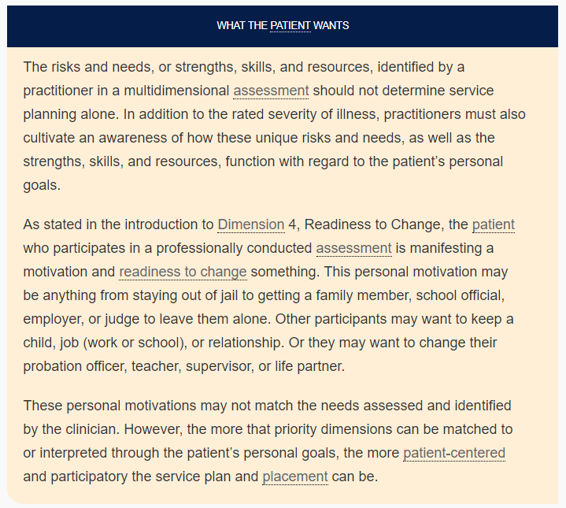
Mee-Lee, D., Shulman, G.D., Fishman, M.J., Gastfriend, D.R., Miller, M.M., et al. The ASAM Criteria: Treatment Criteria for Addictive, Substance-Related, and Co-Occurring Conditions. 3rd edition. Carson City, NV: The Change Companies, 2013.
Page 11

Slide 12
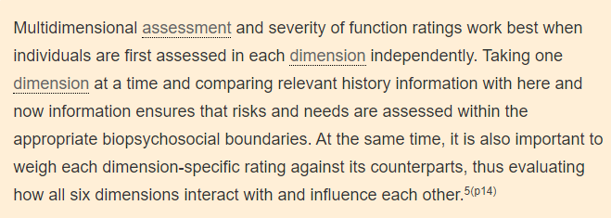
Mee-Lee, D., Shulman, G.D., Fishman, M.J., Gastfriend, D.R., Miller, M.M., et al. The ASAM Criteria: Treatment Criteria for Addictive, Substance-Related, and Co-Occurring Conditions. 3rd edition. Carson City, NV: The Change Companies, 2013.
Page 12

Slide 13
Initial Stabilization or Initial Treatment Plan
Identifies immediate problems or needs, strengths, skills, and priority formulation
Short-term measurable goals and preferences along with activities designed to achieve those goals.
Plan is developed in collaboration with the patient and reflects the patient’s personal goals.
Mee-Lee, D., Shulman, G.D., Fishman, M.J., Gastfriend, D.R., Miller, M.M., et al. The ASAM Criteria: Treatment Criteria for Addictive, Substance-Related, and Co-Occurring Conditions. 3rd edition. Carson City, NV: The Change Companies, 2013.

Slide 14
Initial Stabilization or Initial Treatment Plan
Per MN Statute 245G.05
Review is conducted at a specified time which is noted in the plan, or more frequently as needed (weekly or monthly) depending on level of care being provided.
Be sure to have the client and counselor signature!
If verbal consent was obtained by client, document date.
For example: “John Doe was unable to sign treatment plan due to telehealth services. Verbal consent was obtained on 8/24/2021.”
Discharge planning paragraph can also be included here.

Slide 15
Measurable Goals and Objectives
Goals: Something achieved that you cannot see.
Goals are based on the problem statements and reasonably achievable
in the active treatment phase
Objectives: Something that you can see
Objectives are behaviorally measurable.
Gold Standard: SMART goals and objectives
| Specific
| Measurable
| Attainable
| Realistic
| Time-bound

Slide 16
Examples of Goals (1)
Non-measurable Goal | Measurable Goal
“I want to develop an awareness of my relapse triggers and cues; and practice a healthy relapse prevention plan when I need to.” | I want to develop an awareness of at least one trigger or cue; and practice at least one strategy from my relapse prevention plan.
“I will identify patterns and behaviors that surround substance use.” | I will identify one behavior in the next week that contributes to my substance use.
“Establish a daily mental health regimen and maintain stable mental health.” | Get a mental health evaluation completed within three months and establish mental health counseling if recommended.

Slide 17
Example of Goals: (2)
Should include:
frequency (how often it will be done ex weekly)
amount (how long it should be done ex 30 minutes)
duration (when it's expected to be completed)
Goal: Verbalize and understanding of the need for abstinence
-Improve by adding measurable amount
ex: Increase understanding of the need of abstinence by 25%
Objective: Identify behaviors that led to use
Intervention: Help the client identify behaviors associated with use (Improve by adding measurable amount ex: 5 behaviors associated with use)
Goal: “I want to improve my short-term memory better.”.
Objective: Client will increase memory skills by 25%
Remain abstinent from all mood-altering substances
Report withdrawal concerns
Identify 5 peers to contact during triggering or high-risk situations
Submit to urinalysis screens
Goal 2 is individualized and measurable.
Goal 1 does not appear individual to client’s desire & cannot be measured for completion of the goal

Slide 18
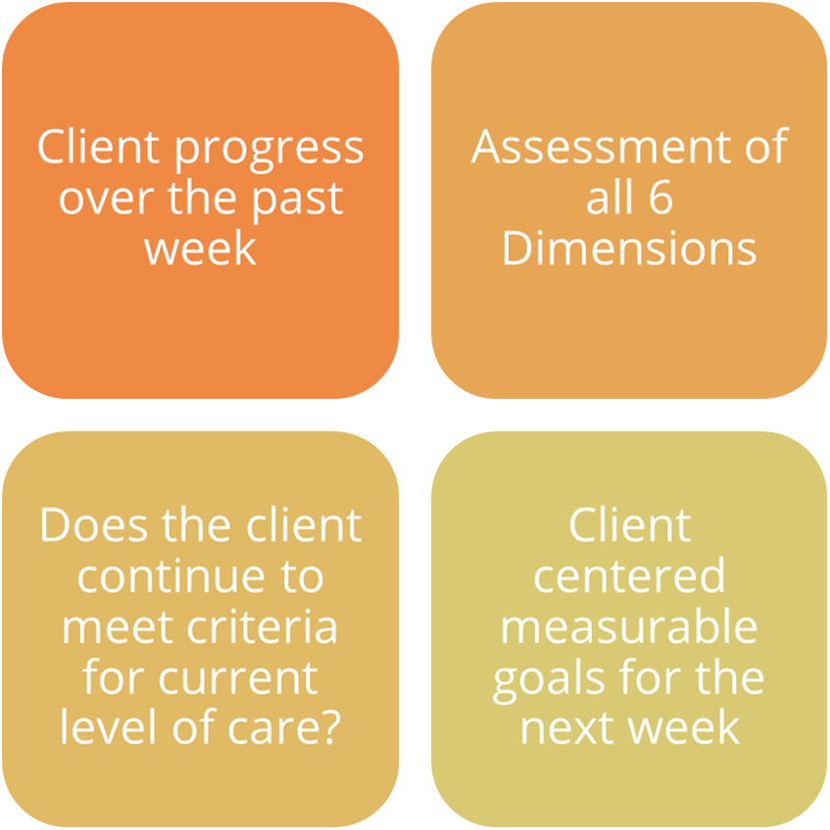
Integrated Progress Notes
Client progress over the past week
Assessment of all 6 Dimensions
Does the client continue to meet criteria for current level of care?
Client centered measurable goals for the next week
Mee-Lee, D., Shulman, G.D., Fishman, M.J., Gastfriend, D.R., Miller, M.M., et al. The ASAM Criteria: Treatment Criteria for Addictive, Substance-Related, and Co-Occurring Conditions. 3rd edition. Carson City, NV: The Change Companies, 2013.

Slide 19
Treatment Plan Review
Continued Service Criteria:
Does the client meet the current LOC requirements?
(pg. 300 – 306 in ASAM manual)
Conducted at a specified time as noted in the original treatment plan
Includes monitoring of biomarkers and/or toxicology testing
Mee-Lee, D., Shulman, G.D., Fishman, M.J., Gastfriend, D.R., Miller, M.M., et al. The ASAM Criteria: Treatment Criteria for Addictive, Substance-Related, and Co-Occurring Conditions. 3rd edition. Carson City, NV: The Change Companies, 2013.

Slide 20
Discharge | Transition Summary
In the process of patient assessment, certain problems and priorities are identified;
The treatment of which indicates admission to a particular level of care.
The resolution of those problems and priorities determines:
when a patient can be transferred and treated at a different level of care,
referred to a different type of treatment
or discharged from treatment. (pg. 299)
Mee-Lee, D., Shulman, G.D., Fishman, M.J., Gastfriend, D.R., Miller, M.M., et al. The ASAM Criteria: Treatment Criteria for Addictive, Substance-Related, and Co-Occurring Conditions. 3rd edition. Carson City, NV: The Change Companies, 2013.

Slide 21
ANG Provider Portal
PART 2

Slide 22
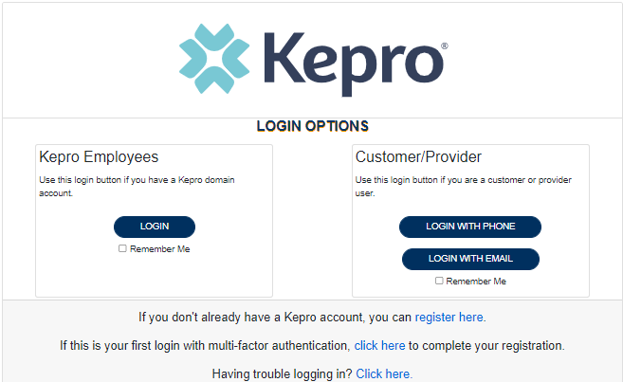
ANG Provider Portal
Training Website:
For in-depth training on the new ANG Platform, please visit:
mhcp.Kepro.com/training
> ANG Provider Portal
Training Video Link:
MHCP ANG Provider Portal Create Case Wizard Training Video
ANG Provider Portal allows for:
Secure access to ANG Connect (Provider Portal)
Provider will be able to access letters by Case/Request, Respond/Send messages To/From KEPRO
Receipt of a Kepro Case ID# to confirm Kepro has successfully received your submission.

Slide 23
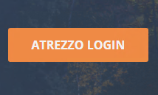
Accessing ANG (Atrezzo) Provider Portal
Email Kepro1115SUD@kepro.com
Provider Reaches out to Kepro1115SUD@kepro.com with 1115 Approval Letter and NPI to obtain their registration number
Select Atrezzo Login
Website: https://portal.Kepro.com
Registered Provider:
Complete Registration and create username

Slide 24
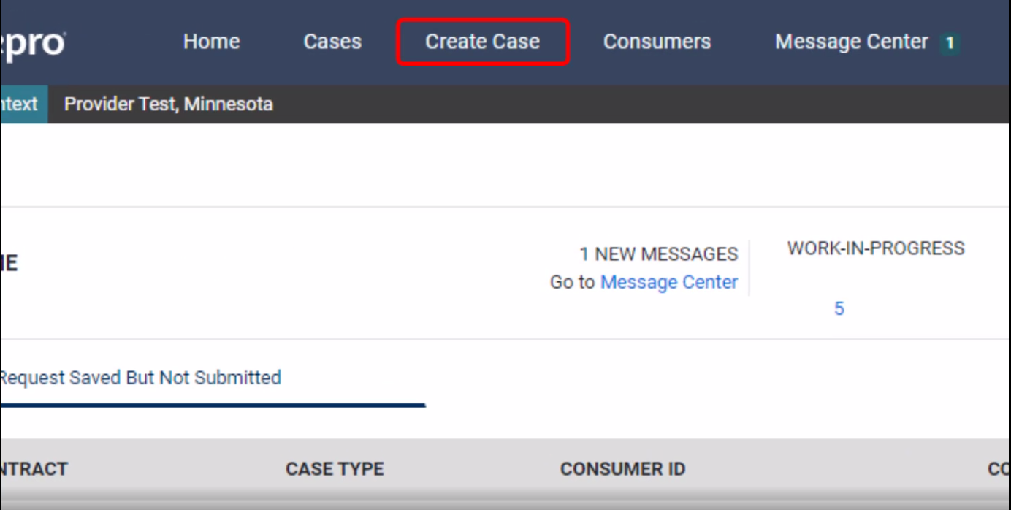
ANG Provider Portal
Successful Completion of setup/login directs user to the Home Page
After logging in from the home screen, click on “Create Case”.

Slide 25
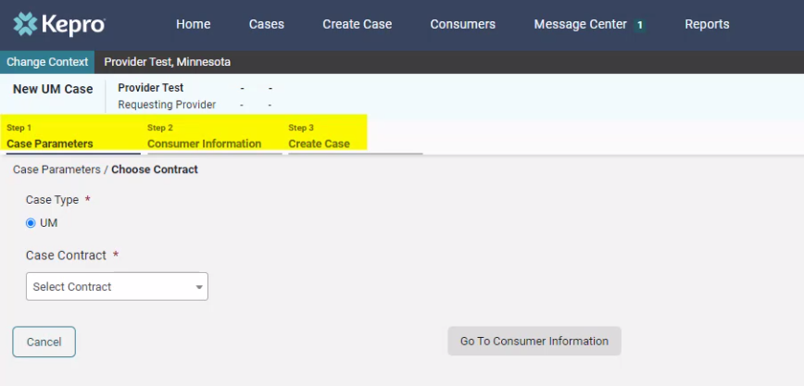
ANG Provider Portal
The Create a Case Wizard shows each section as a Step. The required information will be indicated by a red asterisk (*).
Create Case Wizard

Slide 26
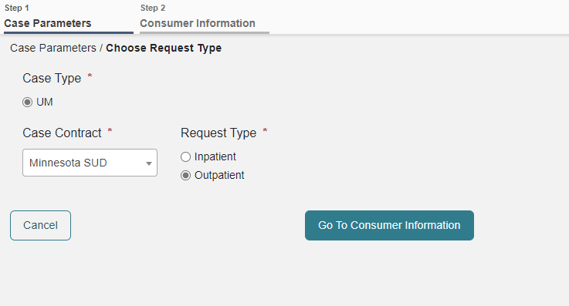
ANG Provider Portal
Case Parameters
Choose:
Case Type: “UM”
Case Contract: “Minnesota SUD”
Request Type:
Inpatient: LOC 3.7WM or 3.2WM
Outpatient includes Residential Services: LOCs 3.5, 3.3, 3.1, 2.1, and 1.0
Click “Go To Consumer Information” to continue.
Step 2
Step 1
Step 3

Slide 27
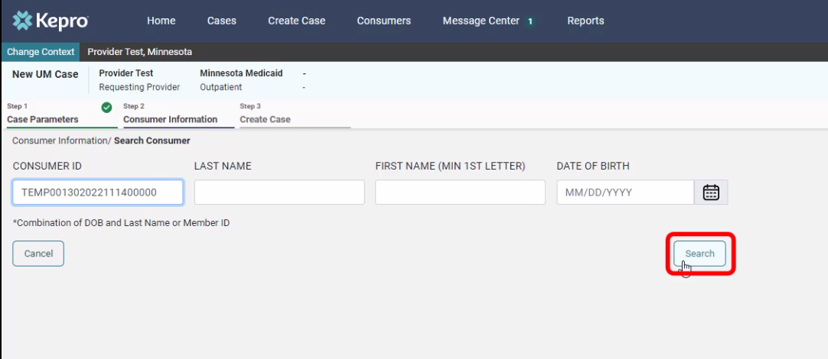
ANG Provider Portal
Consumer information
Search members by:
MN Member ID
Last Name & DOB
Click “Search to continue”

Slide 28
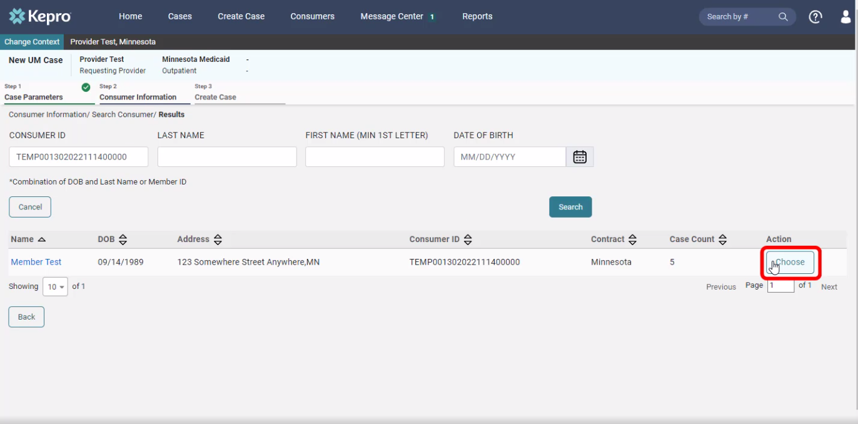
ANG Provider Portal
The members demographic information will display.
Consumer information
Verify member information.
Click “Choose” to continue.

Slide 29
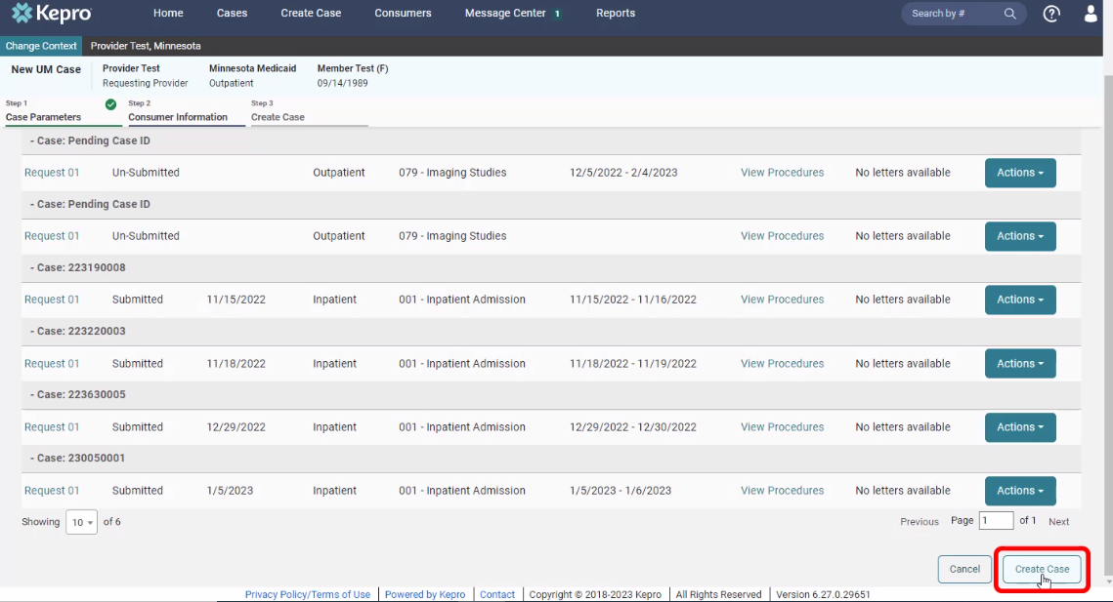
ANG Provider Portal
Consumer information
Previous cases submitted for this member will be displayed.
Click on “Create Case” to continue.

Slide 30
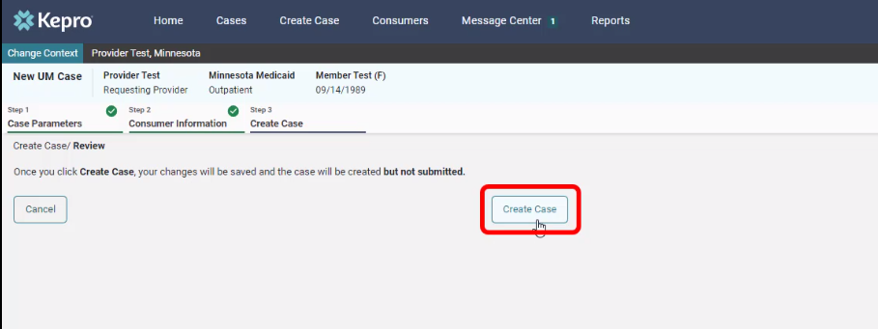
ANG Provider Portal
Disclaimer
CREATE CASE
Notification prompt displays:
“Once you click Create Case, your changes will be saved and the case will be created; BUT
Case WILL NOT be submitted”

Slide 31
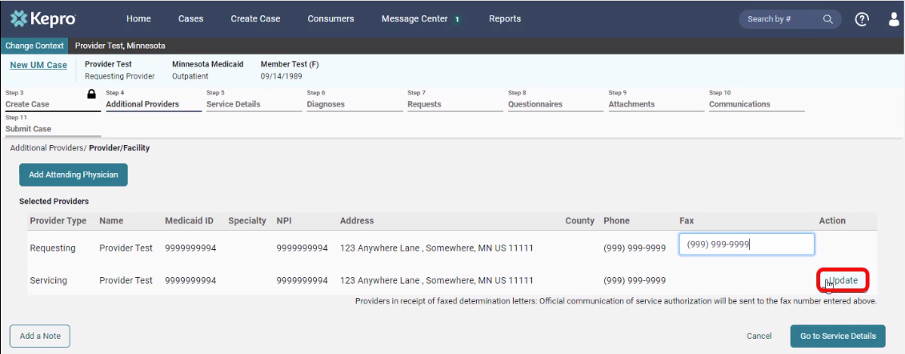
ANG Provider Portal
Additional providers
Entering the attending physician is not necessary for 1115 SUD
Update the Servicing Provider by clicking on “Update”

Slide 32
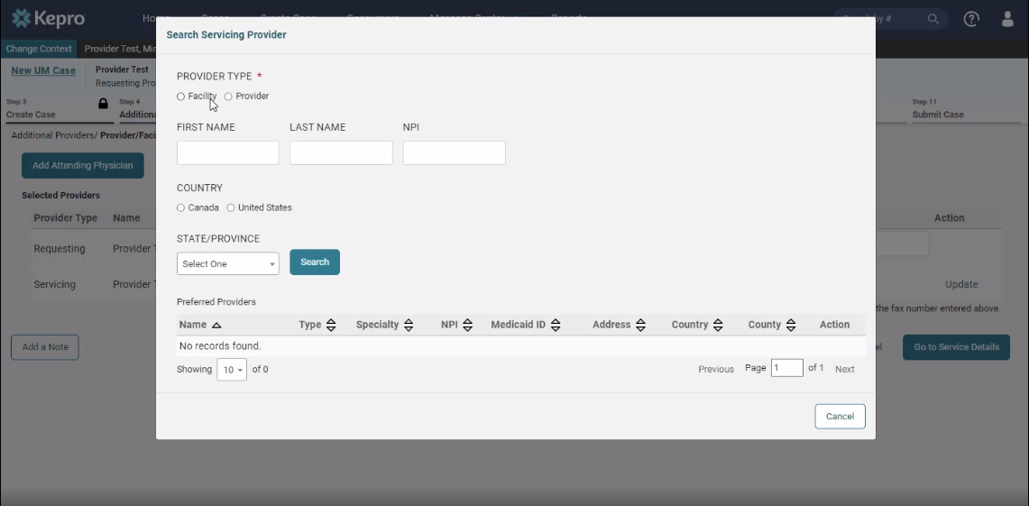
ANG Provider Portal
ADDITIONAL PROVIDERS
If registered as a facility, search using “Facility”.
If registered as a provider, search using “Provider”.

Slide 33
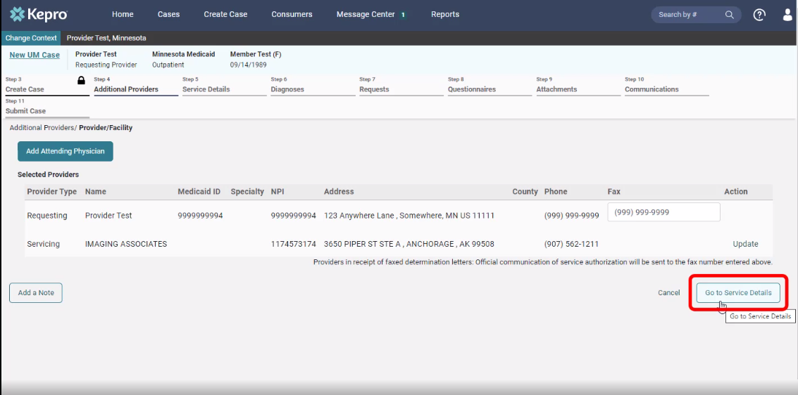
ANG Provider Portal
Fips code
Verify provider information
Click on “Go to service details” to continue.

Slide 34
ANG Provider Portal
11
Service details
Choose:
Place of Service: Optional
Service Type: SUD IP or SUD OP
Click on “Go to Diagnosis” to continue
SUD IP- Substance Abuse– IP Hospital
SUD OP- Substance Abuse
Service Type seen will vary based on the Request Type (Inpatient or Outpatient

Slide 35
ANG Provider Portal
12
diagnosis
Choose:
Code Type: “ICD 10” from the drop down,
Enter the diagnosis code to search.
Select the correct code from the drop down,
Click “Go to Requests” to continue
Select SUD Diagnoses/Mental Health Diagnoses

Slide 36
ANG Provider Portal
13
requests
Choose Request Type
Admission= beginning treatment
Concurrent= client is currently receiving treatment
The notification date and time will display.
Click on “Go to Procedures” to continue.
FIPS Code field is not required for 1115 SUD submissions, leave blank and continue.

Slide 37
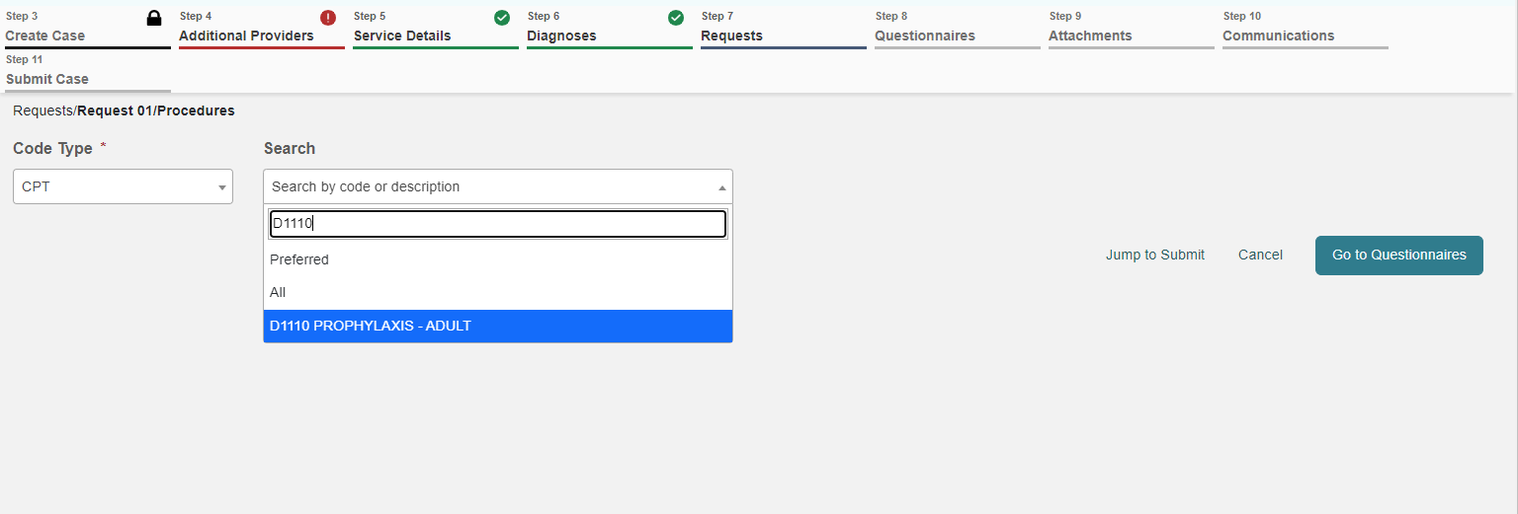
ANG Provider Portal
14
requests
Enter the procedure code in search bar:
This will be the CPT Code billed to DHS
Check with your billing person if unsure on what code to use
Select the correct code from the drop-down.
The Monthly Records Request Letter contains code required for each client
H2036
Residential Program

Slide 38
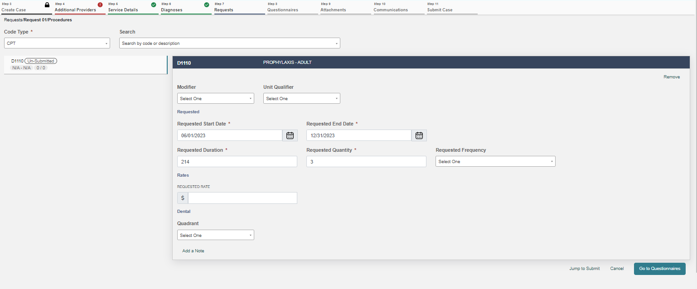
ANG Provider Portal
15
Requests
REQUEST 01 WILL DISPLAY
Enter Requested Start Date.
Enter the Requested Duration (this will populate the correct Requested End date).
The start date will be the date client entered that episode of care
End Date will vary as noted:
Discharge Date
Residential Cases: 1 month (if still in services)
Outpatient Cases: 3 months (if still in services)
Enter the Requested quantity.
Repeat the process for additional procedure codes by entering an additional code in the search field.
Click “Go to Questionnaire”
H2036 tx program, per deim
01/01/23
06/30/23
180
5760
Units
Leave Rate Blank
*Providers are not permitted to submit cases as “insufficient information” status (warning message will pop-up that will prompt you to correct the error).

Slide 39
ANG Provider Portal
16
questionnaire
SUD Questionnaire is required to be completed before the case can be submitted
Click on “Take or Open” under Action to complete the questionnaire.
Upon questionnaire completion, click on “Go to Attachments” to upload the documents.

Slide 40
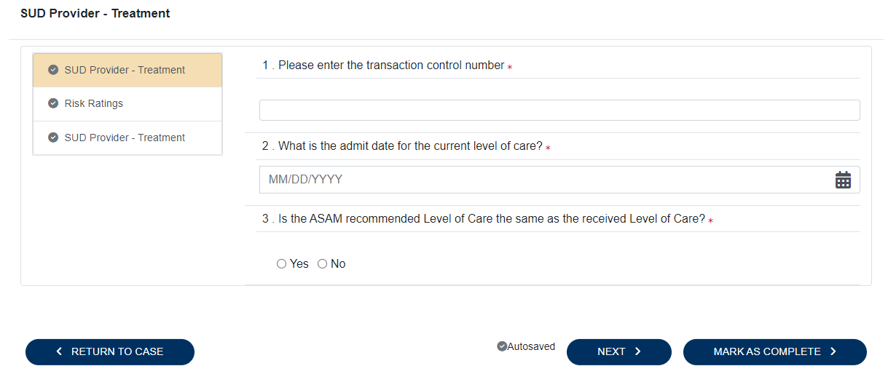
ANG Provider Portal
16
Questionnaire
Transaction Control Number (TCN) is found on Request for Review Letter from Kepro
You may enter more than one TCN
All questions must be answered before the questionnaire can be marked complete
Click “Next” to move through pages
Transaction Control Number (TCN)
Provided to Kepro by DHS
Claims identification number
Used for internal tracking purposes
Must be provided on submitted cases
Included in the monthly letter from Kepro
If there are further questions, please reach out to DHS

Slide 41
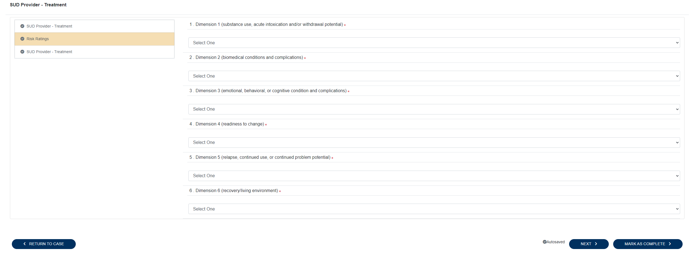
ANG Provider Portal
16
Questionnaire
SUD/ASAM Questionnaire is now included in this questionnaire
Dimension Ratings must be completed for each Dimension
Click “Next” to move through pages

Slide 42
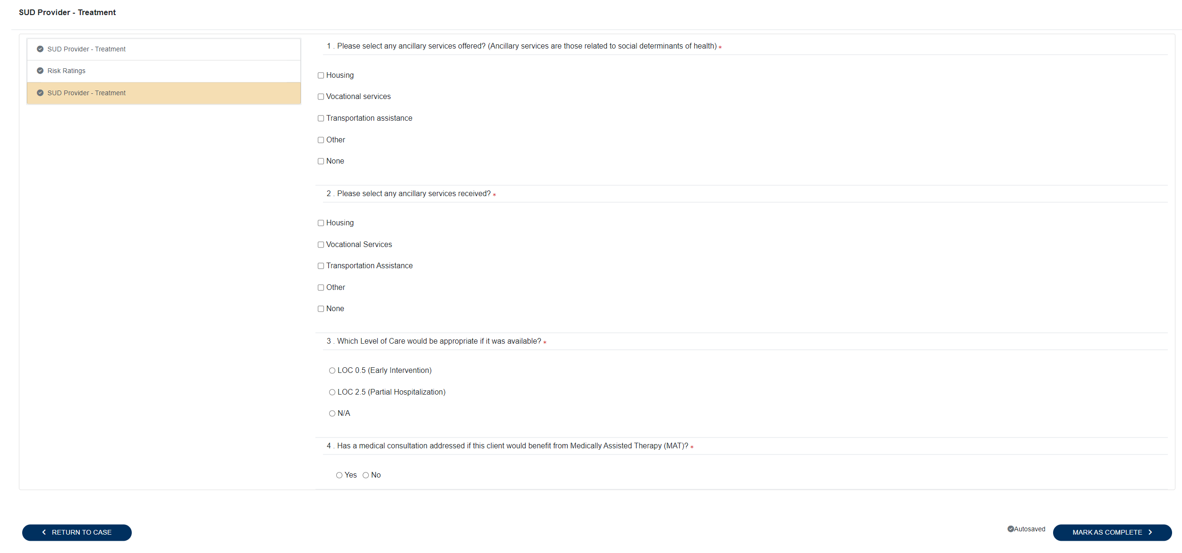
ANG Provider Portal
16
Questionnaire
Select All other services offered and/or provided to client
Question 4 will populate additional questions if MAT would be a benefit to client
Click “Mark as Complete” to finish

Slide 43
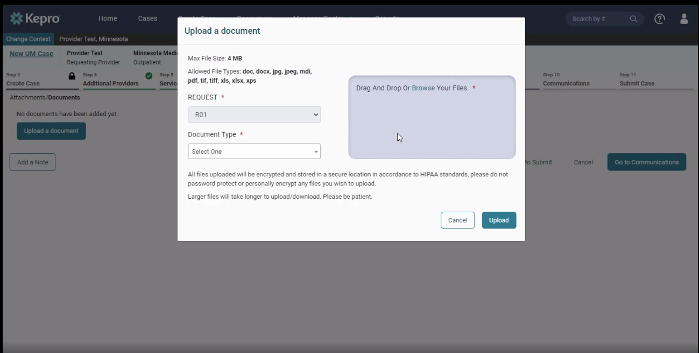
ANG Provider Portal
17
attachments
Click on “Upload documents.”
*You can drag and drop your documents, or you can browse your files.
Choose the appropriate document types
PDF is the preferred file type for uploads
Once the documents are chosen, click on “Upload.”

Slide 44
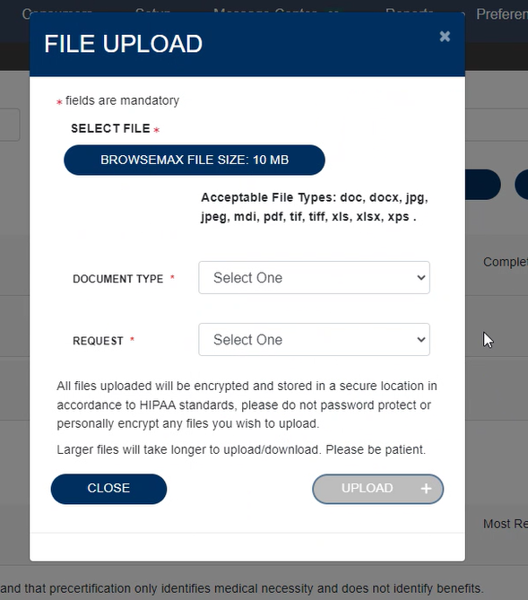
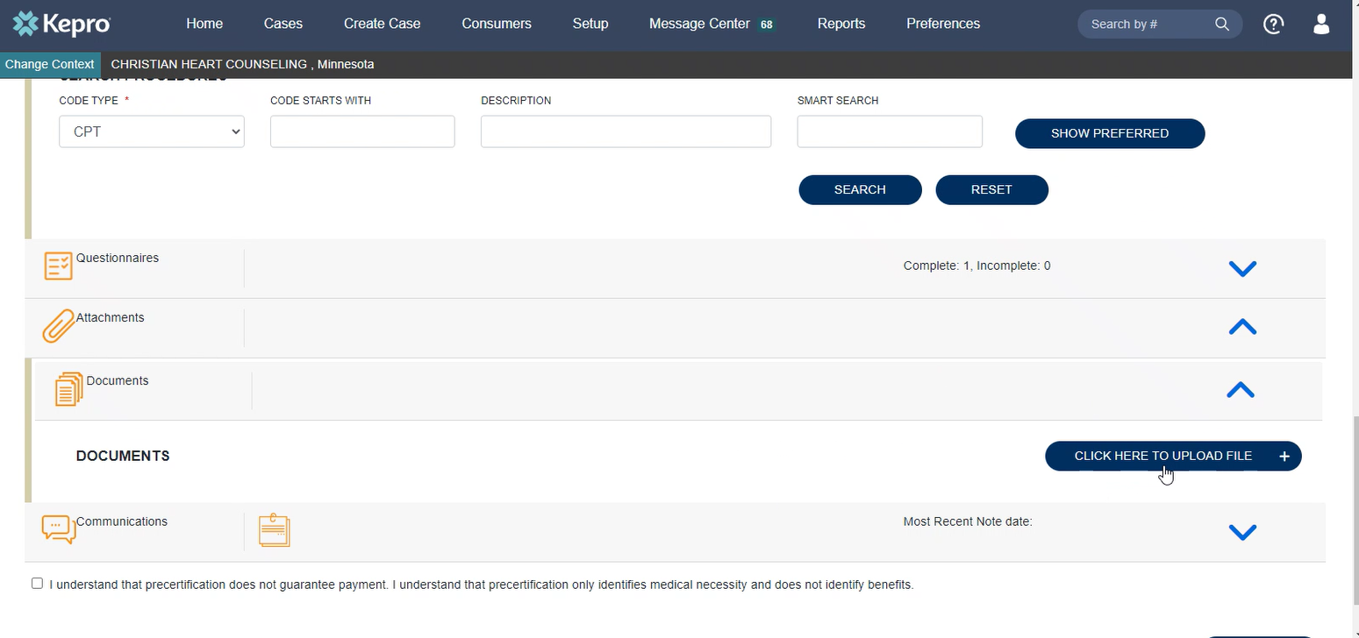
ANG Provider Portal
Step
Attaching documents continued (*same steps for attaching documents to a pended case*)
ADDING ADDITIONAL INFORMATION TO A PENDED CASE
Expand the “Attachments” Folder by pressing on the arrow.
Expand the “Documents” Folder by pressing on the arrow.
Click the “Click Here to Upload” Button.
Upload documents in the same manner as the initial case creation.

Slide 45
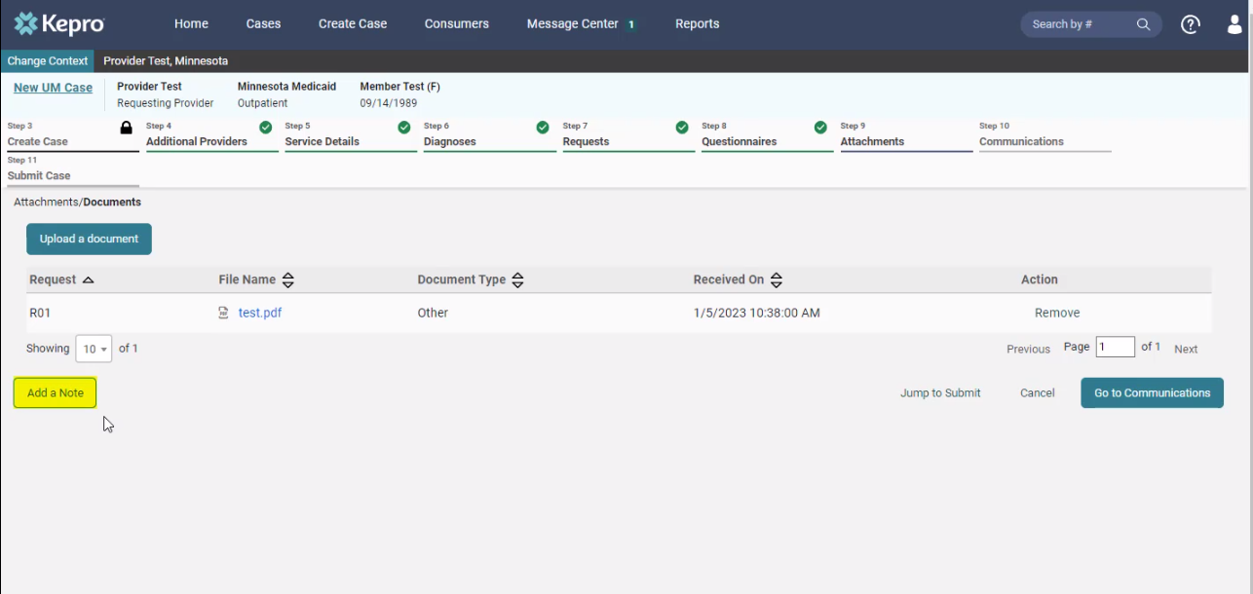
ANG Provider Portal
17
Case note
Each step has a “Add a note” button displayed on the bottom left.
*A note can be added any time throughout the creation of the request; however, it is not necessary.
Examples of case notes:
PPHP/PMAP start and end dates
Discharge Date
Additional TCN (if there was not enough room in questionnaire
*Please be advised when responding to this request, clinical rationale/medical necessity information must be captured within the physical record (written documentation) and not solely entered as a case note.

Slide 46
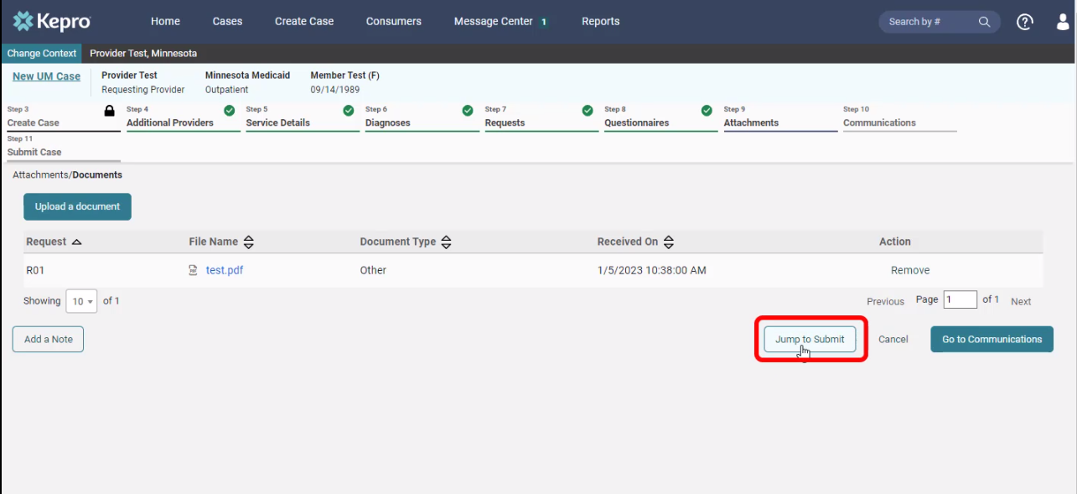
ANG Provider Portal
18
attachments
Click on “Jump to Submit” when all the steps are completed, and a case note has been entered (if necessary).

Slide 47
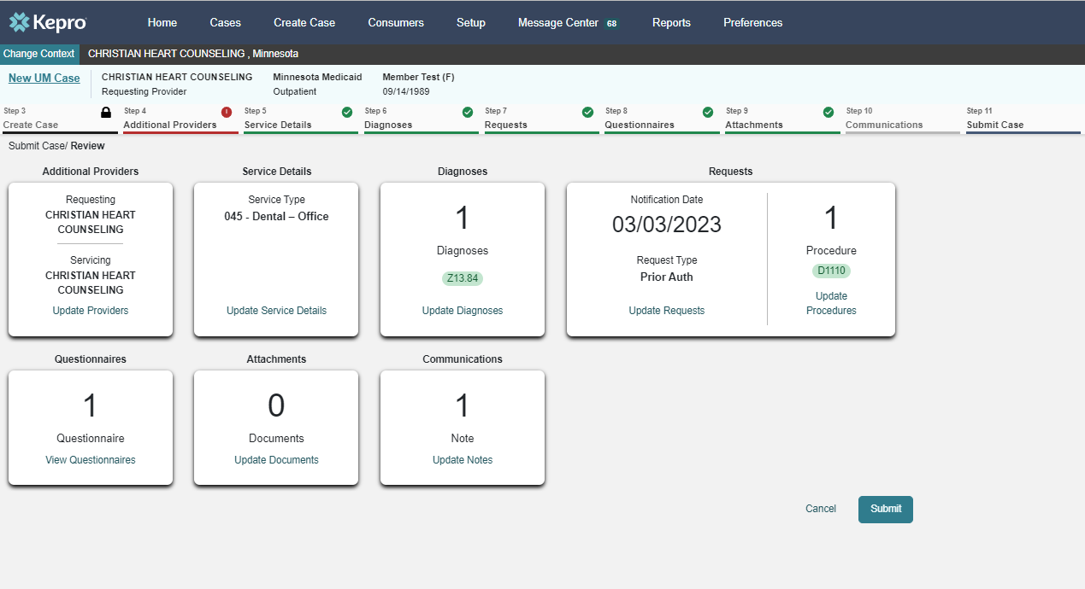
ANG Provider Portal
19
communications
Review the request.
If any changes need to be made, click on “Update” in any section.
If everything is correct, click on “Submit”.
SUD
F15
97153

Slide 48
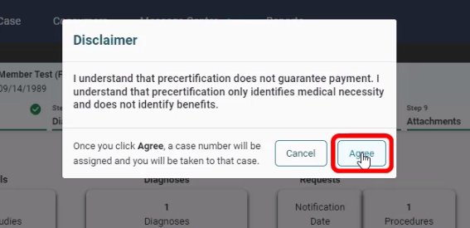
ANG Provider Portal
20
disclaimer
Click “Agree” on the disclaimer.

Slide 49
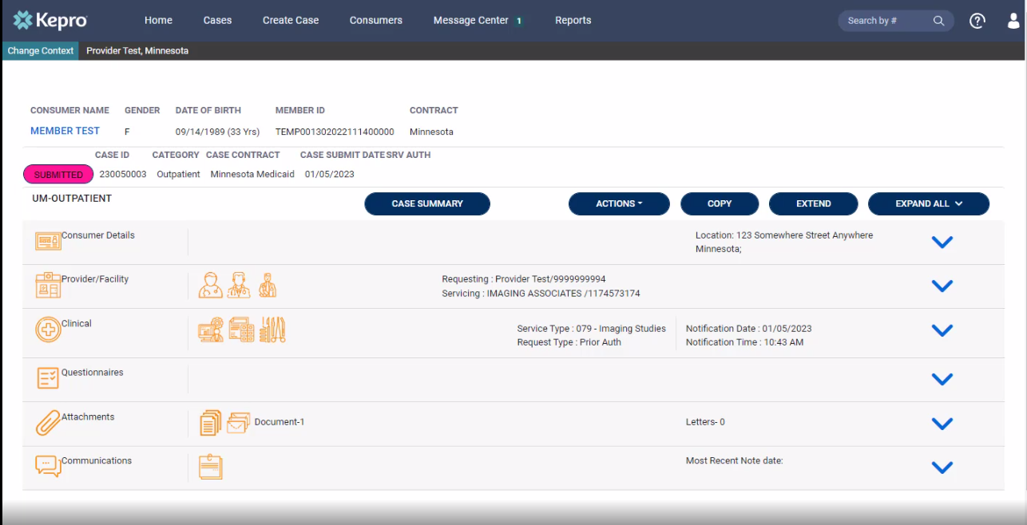
ANG Provider Portal
21
completion
Completed request that is now ready for review by Kepro staff.
Please print or record case number. This will allow for tracking case status, checking for pended information requests or to enter questions into the messaging system.

Slide 50
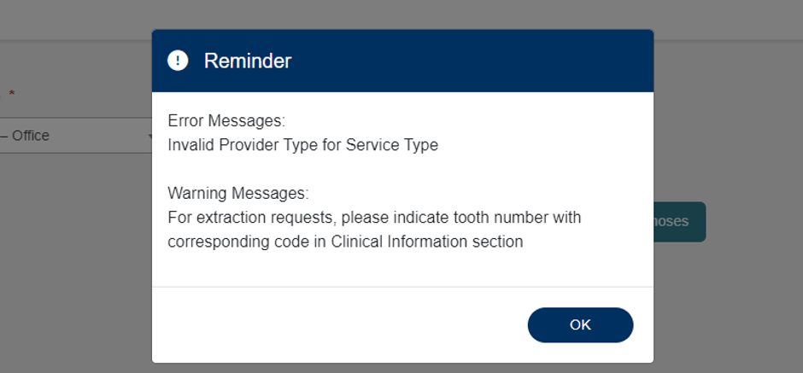
ANG Provider Portal
22
Error messages
If applicable, error messages will appear, prohibiting request submission.
Errors will disappear as information is added or corrected.
If “Invalid Provider Type” error message appears, an incorrect provider type was selected.

Slide 51
ANG Provider Portal
23
Extend a Case
If client is still in services and a case needs extended
Select 3 dots (…) in right corner
Select Extend
From here you will add any CPT Codes, New Dates, and Add Documentation
Then Submit Case

Slide 52
Additional Training Opportunities
1115 Substance Use Disorder (SUD) System Reform Demonstration Clinical
DHS - 1115 SUD Trainings
Kepro Provider Portal Registrations and Training (this presentation will be uploaded there)
https://mhcp.kepro.com/training
American Society of Addiction Medicine
www.asam.org

Slide 53
Acentra Training Opportunities
MONTHLY: Acentra training series on Provider Portal and other necessary topics.
Monthly: 2nd Friday | 11:00 12:00 pm CST
QUARTERLY: 1115 SUD Lunch & Learn
Current SUD topics. First topic: ASAM Overview
Quarterly: 4th Wednesday of last month in quarter
Quarterly Lunch & Learn Training Link
Monthly Acentra Provider Training Link

Slide 54
Question & Answer

Slide 55
Thank you for attending!
Please reach out with any questions you may have.
Additional clinical questions?
Need to obtain your Registration Number?
kepro1115SUD@kepro.com
Questions about the 1115 SUD System Reform Demonstration:
1115demonstration.dhs@state.mn.us

