Slide 1
MN SUD Prior Authorization Submission Requirements
Utilization Management Provider Training
Notes:
☺
(5 minutes before training)
Introduction: Good afternoon everyone. Just like Emily mentioned in the chat, we will start the training right about 1:00 PM today. Please go ahead and use the Q&A function during the webinar or come off mute to ask questions as well.
We will do our best to answer any of our questions that you may have.
Good afternoon, everyone. My name is Becky Meyer. I'm the operations director here at Acentra. I oversee the Minnesota Medicaid and the 1115 demonstration programs here. I am a licensed clinical counselor with both experience in substance use and mental health services. And then on the webinar here, we also have Emily. She's our clinical lead for substance use care and services here at Acentra. We have worked with many of you through the 1115 demonstration.
The purpose of this webinar is going ensure providers are prepared for submitting authorization requests to us through the Atrezzo provider portal.
Let's go ahead and get started.
(Next slide)

Slide 2
Table of Contents
Introduction
Important Claims Information
Requesting an Authorization
Registering for the Provider Portal
Documentation
Documentation Standards
Authorization Process
Submitting the First Request
Determining the Authorization Request
How to Ask For More Units
Resources
Notes:
We have quite a lot of information to get through this afternoon. We’ll be going over important claims information, how to request an authorization, registering for the provider portal, documentation standards, submitting your first request to us, determining the authorization request and then how to ask for additional units past the initial 28-day request.
Insert comment at beginning of training presentation to address rebranding.

Slide 3
PART One
Important Claims Information
Notes:
The first thing we want to make sure providers are aware of is how this will impact claims. This process will require split billing.

Slide 4
Split Billing Required
This process will require split billing for anything that goes over the 6 hours/units per day; and/or the 30 hours/units per week.
As providers you will need to submit one claim for services provided that are up to six hours/units a day or 30 hours/units a week using your normal process.
A second claim will have to be submitted using the authorization number that you receive from Acentra to bill for services over 6 hours/units per day and/or 30 hours/units per week.
A week is defined as a rolling 7-day period.
The authorization is given for a maximum of 28 days.

Slide 5
PART two
Requesting an Authorization
Notes:
☺

Slide 6
3 Ways to Submit an Authorization
Via Atrezzo Provider Portal
Fax
Mail
Address:
Acentra Attention: MN Medicaid 6802 Paragon Place, Ste 440 Richmond, VA 23230
Delayed submission
Include all required documentation
Will not receive case ID as confirmation
Preferred method
Fewer errors
Case ID is confirmation that we received the request
Allows for direct communication with review staff
Fax DHS-4695 to 866-889-6512
Include all required documentation
Will not receive case ID as confirmation
MHCP Provider Manual Authorization page to be updated in March 2024 when authorization requirements begin.
Notes:
There are three ways to submit an authorization request to Acentra; via the provider portal, fax, or mail. The preferred method is via the Atrezzo provider portal. Providers that are already enrolled in the 1115 Demonstration Project already use the portal. This process will be slightly different and we will point out the differences as we go along.
One of the reasons we like the provider portal is that it results in fewer errors due to providers being able to request exactly what you want, with as many units as you want. As soon as you submit it to us, you will receive a case ID and that's your confirmation number that we have received the request.
The Atrezzo Provider Portal also allows for direct communication with the review staff.
Like mentioned earlier: The other two options that we accept authorization requests for Minnesota Medicaid providers is to fax or mail the DHS-4695 authorization form and all required documentation to us or you can also mail it.
Assuming that most of you will use the portal; we will continue the training with how to register for the Atrezzo Provider Portal.

Slide 7
PART three
Registering for the
Provider Portal

Slide 8
Yes
Contact “MinnesotaASAM@Acentra.com
For your registration number
Are you or will you be enrolling as a
provider with the
1115 Demonstration Project?
Contact MNProviderIssues@kepro.com or 1-866-433-3658
For your registration number
No
Yes
No need to register a second time.
Are you already enrolled and approved as an 1115 Demonstration provider?
No
See above process.
Notes:
We know that a lot of providers on this call are already enrolled in the 1115 demonstration. Please note that this video does have an old email address listed on it. If you are going to be enrolling in the 1115 Demonstration the email address we would like you to use is: MinnesotaASAM@acentra.com for your registration number. If you are not going to be part of the demonstration project then contact MNproviderissues@kepro.com or at the 1-800 number and the customer services team will provide you with your registration number.
Also, if you are already enrolled and approved as a demonstration provider, you don't need to register a second time. You will just submit your authorization requests to us slightly differently.
Next we’re going to watch a video next here that's going to go through the registration process .

Slide 9
Notes:
☺

Slide 10
PART four
Documentation
Requirements and Standards

Slide 11
Documentation Requirements for the Initial Request
Current Comprehensive
Assessment
Most recent Treatment Plan
or Treatment Plan Review
(or Initial Services Plan if request is prior to completion of comprehensive assessment)
signed by clinician and client
Questionnaire
Progress notes
Questionnaire or DHS Form (see here for more details)
Progress notes, treatment plan reviews or integrated treatment plan reviews
* DHS-4695-ENG MHCP Authorization Form is required on all requests if not using the portal.
Notes:
Initial Documentation Recommendations
Clinical Documentation Needed for initial:
Comprehensive Assessment (or Initial Services Plan to justify immediate need of 6+ hours of care)
Most recent treatment plan or treatment plan review that has been signed by the clinician and client
Progress notes if not documented in treatment plan review
Questionnaire/form that answers med nec questions*
*Provide clinical justification for need of more than 6 hours/day or 30 hours/week of services (via form or questionnaire):
Narrative of what has been seen in the recipient’s behavior/treatment that indicates need for additional treatment
Breakdown of how the hours will be used in a day and/or week
How the clinician expects the extra services to benefit/assist the client in reaching his/her treatment goals
Signed by clinician/client (if form)
We're going to start with the comprehensive assessment or the initial services plan.
Please note if the request is prior to the completion of the comprehensive assessment; we will want the initial services plan. After that you’ll want to submit the initial treatment plan which has been signed by the clinician and the client. And then we're going to be looking for progress notes, if those are not integrated into treatment plan reviews.
Specifically, what we’re looking for is that the treatment plan or treatment plan review show how the services that exceed 6 hours a day or 30 hours a week are helping the client reach their treatment plan goals. This needs to be documented very clearly.
And then finally, there's going to be a detailed questionnaire or form that goes into more detail about how these services are supporting the client.

Slide 12
Documentation Requirements for Continued Authorization past initial 28-day Request
Most recent Treatment Plan
or Treatment Plan Review
Most recent treatment plan
If not imbedded in treatment plan review
Include documentation that demonstrates the impact of the additional hours on treatment and medical documentation for extension
Updated Questionnaire
Progress notes
Questionnaire or DHS Form (see here for more details)
Progress notes, treatment plan reviews or integrated treatment plan reviews
* DHS-4695-ENG MHCP Authorization Form is required on all requests if not using the portal.
Notes:
Additional Requests - Documentation Recommendations
Clinical Documentation Needed for additional/extension of services:
Most recent treatment plan review
Treatment plan review/Progress notes that document the impact of the additional hours on treatment progress
Updated questionnaire/form*
*Provide clinical justification for need of more than 6 hours/day or 30 hours/week of services (via form or questionnaire):
Narrative of what has been seen in the recipient’s behavior/treatment that indicates need for additional treatment
Breakdown of how the hours will be used in a day and/or week
How the clinician expects the extra services to benefit/assist the client in reaching his/her treatment goals
Signed by clinician/client (if form)
For subsequent requests after the initial 28 days, we do not need the comprehensive assessment. Then we’ll also be looking for the most recent treatment plan. And again, if not embedded in the treatment plan review, we're going to want updated progress notes as well.
And as a reminder, the documentation needs to demonstrate the impact the additional hours on treatment are having. You will also need to submit an updated questionnaire as well.
And one of the ways providers do that is through the comprehensive assessment.

Slide 13
Comprehensive Assessment
Understanding
“medical necessity”
What it is
What it is not
General medicine
ASAM’s definition
a screening of all biopsychosocial elements
Includes collateral information if possible
A historical document, updated as more information is learned or the client’s situation changes
Informs the risk ratings, but does not solely identify them
Completed by licensed/credentialed providers in his/her own scope of practice
Sets the foundation for medical necessity of services
To be used or completed if the patient is intoxicated or in withdrawal. Consider immediate referral for medical evaluation or withdrawal management services.
It is not a diagnostic assessment
It is not a 6-dimension assessment
https://www.revisor.mn.gov/statutes/cite/245G.05
Notes:
The comprehensive assessment sets the foundation for treatment. It provides the reader and clinician an understanding of the entire person so that treatment can be focused on helping the person from a holistic lens rather than only looking at his or her addiction.
Comprehensive assessments should also include collateral information if possible, and most importantly, it's a historical document that should be updated as more information is learned or the client situation changes.
A comprehensive assessment, should also be completed by a licensed or credentialed provider in his or her own scope of practice.
So what isn't it? It's not a diagnostic assessment. It's not an ASAM 6 dimension assessment. However, the information from the comprehensive assessment may impact those other assessments.
And of course, it should not be used with somebody who is intoxicated or in withdrawal, because we want the client to be fully engaged.
We also want to take a few minutes to review risk ratings as those are entered both into DAANES and are a part of the Comprehensive Assessment.

Slide 14
Risk Ratings
This risk would indicate a non-issue or very low-risk issue. The patient would present no current risk and any chronic issues would be mostly or entirely stabilized.
This rating would indicate a mildly difficult issue, or present minor signs and symptoms. Any existing chronic issues or problems would be able to be resolved in a short period of time.
This rating would indicate moderate difficulty in functioning. However, even with moderate impairment, or somewhat persistent chronic issues, relevant skills, or support systems may be present.
This rating would indicate a serious issue or difficulty coping within a given dimension. A patient presenting at this level of risk may be considered in or near “imminent danger.”
This rating would indicate issues of utmost severity. The patient would present with critical impairments in coping and functioning, with signs and symptoms, indicating an “imminent danger” concern.
Low Moderate High
Notes:
A risk of zero should indicate a non-issue or a very low risk issue. If the patient had any chronic issues these would be mostly or entirely stabilized.
As you can see this is going to go all the way to four, which would also show us that the client has significant issues and impairments in both their coping and functioning. With a risk rating of four we would want to look at any sort of things in their lives that are of imminent danger or concern that need to be immediately addressed.

Slide 15
This is a good example
Current/past MAT services
How many times have gone through w/d
How long have symptoms been occurring
How severe are symptoms
Any history of medical concerns that could impact withdrawal
Treatment history
Notes:
Examples of descriptions specifically for Dimension 1 in the comprehensive assessment you can see here.
Additionally, you can see go to the statutes for a breakdown of what is required in the comprehensive assessments.
Similar to the comprehensive assessment, there are statute guidelines for the individual treatment plans.

Slide 16
Individual Treatment Plan
What it is
What it is not
Should not include:
Involves problems, needs, strengths, skills, and prioritizing the problem areas that the client wants to work on
Short-term, measurable treatment goals and preferences are articulated along with activities designed to achieve those goals.
Developed with client and reflects the patient’s personal goals
Shows the importance of treatment and how client is going to return to baseline
Programmatic or prescriptive
Driven by the therapist
Relapse prevention if client is in pre-contemplation or contemplation stages of change
https://www.revisor.mn.gov/statutes/cite/245G.06
Notes:
What is it? What isn't it and what it should or shouldn't include?
The most important thing is that we want the treatment plan to be collaborative with the client. Clinicians should want clients to have of ownership of the treatment plan to start building treatment engagement. Additional the treatment plan goals should be measurable and focus on the things that the client identifies as important.
The treatment plan should also address how those services that go beyond 6 and 30 hours/units help the client reach their treatment goals. Those goals should be specific, measurable goals and it should not be programmatic or prescriptive.
Treatment plans should also show how the services being provided to the client are specific to that individual client.

Slide 17
What the Patient Wants
The risks and needs, or strengths, skills, and resources identified in a multidimensional assessment do not determine service planning alone.
Practitioners must cultivate an awareness of how these unique risks and needs, as well as the strengths, skills, and resources, function with regard to the patient’s personal goals.
The patient who participates in a professionally conducted assessment is showing motivation and readiness to change something. (i.e. staying out of jail to getting a family member, school official, employer, or judge to leave them alone.) Other participants may want to keep a child, job, or they may want to change their probation officer, teacher, supervisor, or life partner.
Personal motivations may not match the needs identified by the clinician. However, the more that priority dimensions can be matched to through the patient’s personal goals, the more patient-centered and participatory the service plan and placement can be.
Severity of Illness
Cultivate Awareness
Does not determine service planning alone
Risks and needs
Strengths, skills, resources
Functioning
May Not Match Needs Identified by Clinician
Motivation
Readiness to change something
Identify personal goals
Person-centered treatment development
Notes:
Treatment plans should not be driven by the therapist, they should be developed with the client. And this slide here goes through the importance of what the patient wants.
Personal motivations from a client or patient are going to determine how motivated he or she is to participate in treatment to reach the goals.
Additional things that the clinical reviewers will be looking for are the clients strength, needs, skills and any resources they may need. , UM, are being supported in the treatment plan.
Severity of illness may also determine or influence some treatment plan goals.

Slide 18
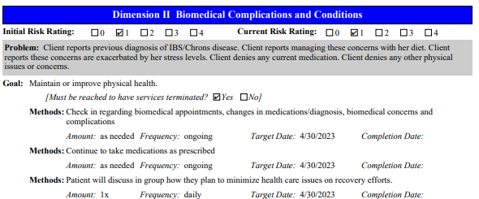
Examples of Treatment Plans – not individualized
Every dimension needs to be addressed; but not every dimension needs a goal.
If there is a “0” risk for withdrawal, why would a goal be to avoid further intoxication.
Random UAs – program requirement, not a goal
Notes:
And then here we have some examples of treatment plans that are not individualized.
I'm not going to read through these word for word, but you can see here how we're really looking for services that support the individual client versus a programmatic feel.

Slide 19
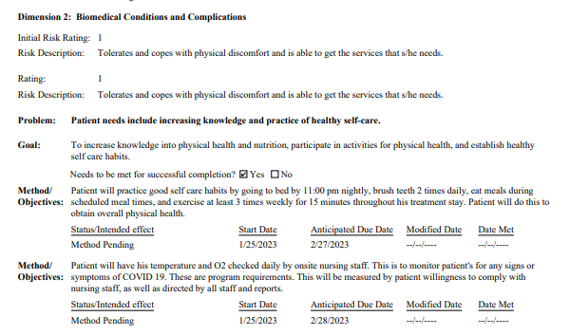
Examples of Treatment Plans – Individualized
Notes:
Then here's an example of individualized ones.

Slide 20
Treatment Plan Reviews and Progress Notes
Need to clearly reflect implementation of the treatment plan and the patient’s response to therapeutic interventions for all disorders treated, as well as subsequent amendments to the treatment plan
Needs to have the initial risk rating; and the updated risk rating for that review period
If a risk rating increases, the treatment plan should address the reason for increase
Identify number of hours of treatment received MN Statute 254B.19
Justification for more/less hours received for that level of care
Notes should include:
Client’s response to all groups and services, including individual therapy
Notes:
Treatment plan reviews and progress notes should include a justification for the number of hours received for that level of care.
Additionally, we want to know what services are provided over six and 30 units. This can be either in the treatment plan review, or separate progress notes. Progress notes or treatment plan reviews should also include the client’s response to all groups and services, including individual therapy.

Slide 21
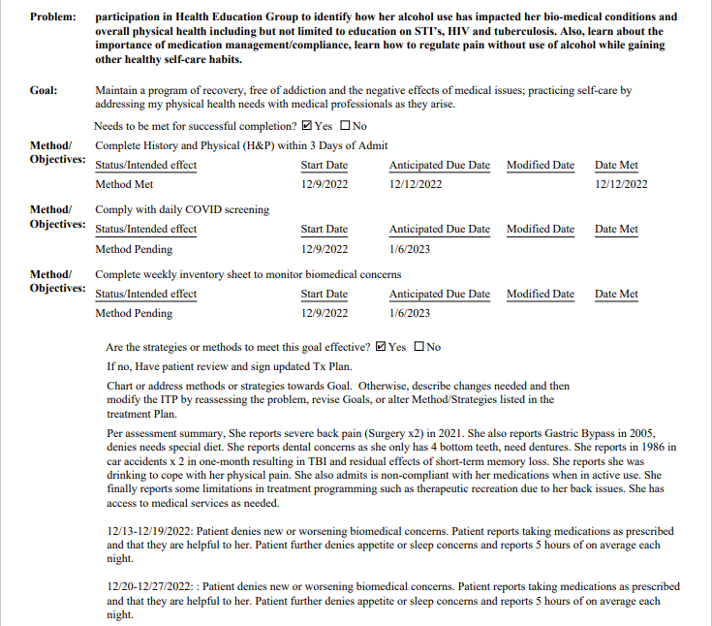
Treatment Plan Reviews and Progress Notes
Goal does not align with problem.
No referral noted for dental services.
Notes do not identify how problem is being solved.
Not individualized. Appear to be copy & paste.
Notes:
This next page is just a little bit more about the treatment plan reviews with integrated progress notes and points out the discrepancy between the goals not aligning with the problem that the client identified. The notes also are not individualized and appear to be copied and pasted.
Before we move into the questionnaire section and talking about what Acentra will be needing, are there any questions or concerns that I might be able to answer regarding the comprehensive assessment, the treatment plan, reviews and progress notes?

Slide 22
Questionnaire/Form Information
Narrative of what has been seen in the recipient’s behavior/treatment that indicates need for additional treatment hours.
Breakdown of how the hours (individual and/or group) will be used in a day and/or week.
How the clinician expects the extra services to benefit/assist the client in reaching their treatment goals.
Name and credentials of the licensed professional providing clinical justification.
Notes:
This is going to be for all requests and will be built into the provider portal. However, if you fax an authorization to us, there will be an additional form that will need to be filled out to answers these questions along with the supporting the documentation that you're submitting to Acentra.
The four things we will be needing are:
What has been seen in the recipient’s behavior or treatment that indicates a need for additional treatment hours.
We want to see clinical judgment with evidence of the individual participant’s needs and a breakdown of how the hours, whether it's individual or group, will be used in a day or a week.
The clinical reviewers are also looking for clinical judgment of how these extra services or hours are going to benefit and assist the client in reaching their treatment plan goals.
And finally, if it's submitted via the portal, we need the name and credentials of the licensed professional providing clinical justification.
Any questions on this?

Slide 23
PART five
Submitting the First Request (Case)

Slide 24
Case Creation Wizard
Notes:
Create Case Wizard Video – need this to be outpatient - hide this slide – replace when Dani gets me new video

Slide 25
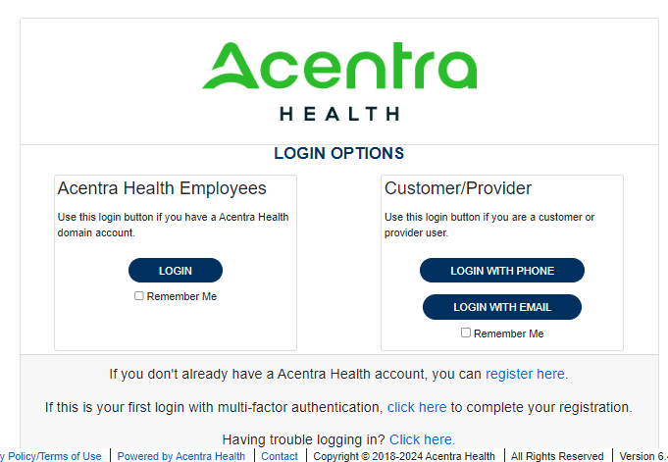
Atrezzo (ANG) Provider Portal
Training Website:
For in-depth training on the Provider Portal, please visit:
mhcp.Kepro.com/training
Training Video Link:
MHCP ANG Provider Portal Create Case Wizard Training Video
Providers can access cases to determine authorization status
Receipt of a Case ID# to confirm Acentra has successfully received your submission.
Notes:
You will be able to submit cases via the portal once you have completed your registration. For additional training feel free to go to mhcp.kepro.com/training or refer back to this training once it’s been published on our website.
If you need to add additional users or anything like that to your account, and so you're going to go ahead and log in here, it's a little small, but it says by phone or by email, so you would just do it however you registered.

Slide 26
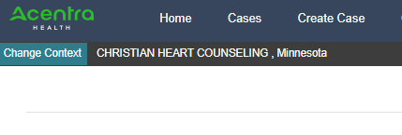
Portal Case Creation
After logging in, click “Create Case”
The Create a Case Wizard shows each section as a Step. The required information will be indicated by a red asterisk (*).
Notes:
The create a case wizard will show each section as a step. And just like in any other web based platform the required information is going to have a red asterisks next to it.
Once logged in, you'll want to click on “Create case”

Slide 27
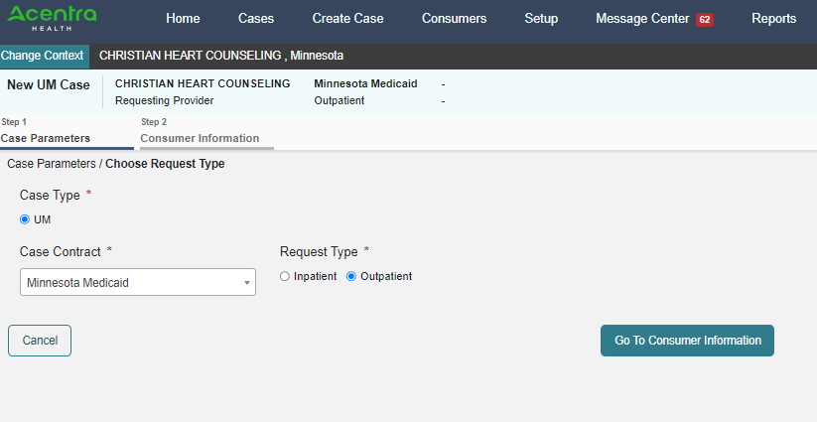
Portal Case Creation - Case Parameters
Case Contract:
Minnesota Medicaid
(not Minnesota SUD)
Request Type:
Outpatient
Notes:
For the first step, one of the things we really want to call out is the Case Contract that you’re going to use.
Many of you are used to choosing Minnesota SUD for the demonstration project and this is a big difference. For the prior authorization process, you will want to choose Minnesota Medicaid from the Case Contract drop down.
After choosing the Case Contract, you’ll want to choose the Outpatient.

Slide 28
Portal Case Creation – Consumer Information
Search for members by:
MN Member ID, or
Last Name & Date of Birth
Click “Search” to continue
Notes:
Then from there you're going to want to search for members by using their Medicaid ID number or by last name and date of birth.
We recommend using the recipient’s Medicaid ID number. Then click “search”.

Slide 29
Portal Case Creation – Verify Consumer Information
Verify member information.
Click “Choose” to continue.
Notes:
And from there, it's going to bring up a list of potential members.
Verify that the recipient’s member information, and then click “choose” to continue.

Slide 30
Portal Case Creation – Check for Duplicates
Previous cases submitted for this member will be displayed.
Verify that this is not a duplicate case request by checking the service dates requested.
Click on “Create Case” to continue.
Notes:
You'll want to see if there are previous cases submitted for this Member. Please verify that it's not a duplicate request by checking the service date.
Once you do that, you'll click “create case”.

Slide 31
Portal Case Creation – Additional Providers
Attending Physician not needed
Verify Requesting and Servicing Provider are the same
Click “Go to Service Details” to continue
Notes:
From there it's going to prepopulate with your requesting provider or servicing provider information.
You’ll want to make sure that the requesting and servicing provider are the same. If they are not the same, reach out to us and we can help you set up your account so that it is.
Be ensuring that the requesting and servicing providers are the same, we can make sure that your authorizations are created correctly with the right address, location, and NPI number.
We do know that there is a system error that lists the counties as wrong; so please don't worry about that.
The attending physician is not needed.
Once you've verified that the requesting and servicing providers are correct, you can go ahead and click start.

Slide 32
Portal Case Creation – Service Details
Intake Method: Web
Place of Service: not needed
Service Type: 062 – Substance Abuse
Click “Go to Diagnoses” to continue
Notes:
From here the case Creation Wizard is going to default to the intake method of being web.
Place of service is not needed. And then under service type choose 62 for substance abuse.
You're going to go ahead and click “Go to diagnosis”.

Slide 33
Portal Case Creation – Diagnosis
Search for all applicable diagnoses
To add diagnoses simply search for the new code and click on it to add to the list
Click “Go to Requests” to continue
Notes:
From there you’ll go ahead and search for all applicable diagnosis. You need a minimum of 1 and then if you wanted to add additional diagnosis, you'll simply follow the same process of searching for the code.
The diagnosis will pop up, click add and add it to the list.
From here, you'll go to the “requests”.

Slide 34
Portal Case Creation – Requests
To make sure that your request gets routed to the right department, only use reconsideration on previously denied cases.
Prior Auth = services which are currently being received which include today’s date or are in the future
Retro = services or dates which have been completed
Click “Go to Procedures” to continue
Notes:
To make sure your request gets routed to the right department, you want to use either prior authorization or retro authorization.
Prior authorization is for services which are currently being received which include today's date or are in the future. Retro is for services dates which are in the past and/or have been completed.
If there is a mismatch with dates, the system will give you an error if you choose the wrong service type or the wrong request type.

Slide 35
Portal Case Creation – Request 01 Procedure
Add all service lines for an individual on one case rather than creating separate cases.
If you need assistance with this, please reach out to MNProviderIssues@kepro.com for assistance. Additional training is also training available at https://mhcp.kepro.com/training.
Only CPT Codes allowed:
H2035 – Individual Treatment
H2035 HQ – Group Treatment
Notes:
To add the CPT Code that you need, you’ll choose “CPT” code type, and search for H2035 for individual or group treatments. Additionally, you'll want to add all service lines for one individual on one case. You do not need to create separate cases.

Slide 36
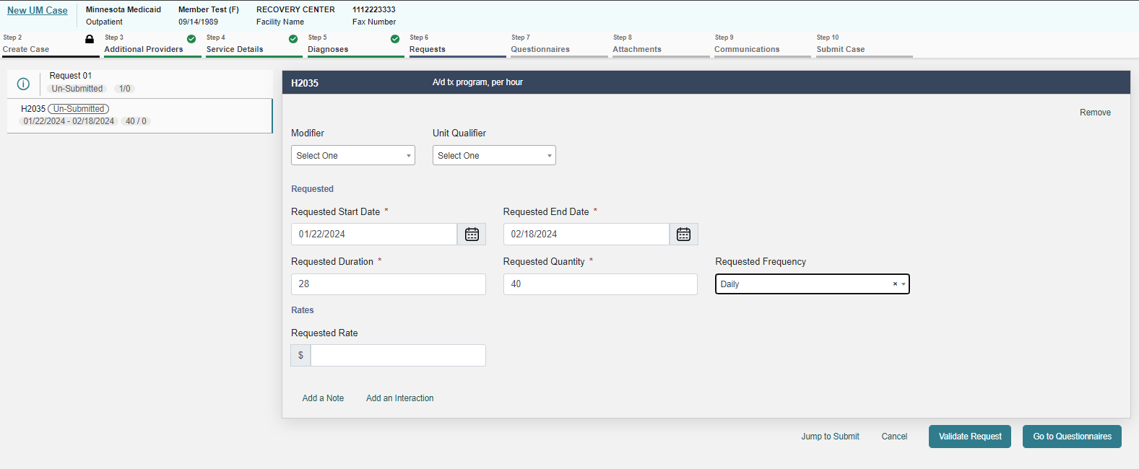
Portal Case Creation – Request 01 Procedure
Duration cannot exceed 28 days
Quantity = how many extra units (above 6 per day or 30 per week do you need?
Click on “Validate Request” to continue
Only CPT Codes allowed:
H2035 – Individual Treatment
H2035 HQ – Group Treatment
Notes:
The first one we’ll review is H2035 for individual treatment. We’ll follow the same process to add a second line with an HQ modifier for group treatment.
Once you've added the H2035, you can see here under modifier that if it was a group you could add an HQ.
You’ll fill in the requested start date. The system will fill in some of the boxes. Leave the requested end date blank and put the duration in and the calendar will automatically update the end date.
Then fill in your quantity. Providers will need to tell us exactly how many extra units you are needing. For example 2 extra hours per day, five days a week for a total of 10 or more than the 30 hours per week that you need.
The reviewers will not figure out the requested quantity for providers.

Slide 37
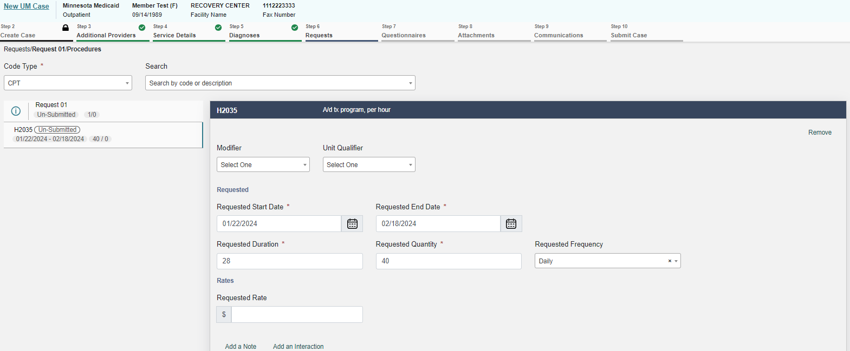
Portal Case Creation – Request 02 Procedure (if needed)
Only CPT Codes allowed:
Add all service lines for an individual on one case rather than creating separate cases.
Search for “H2035” again to create a second line
H2035 – Individual Treatment
H2035 HQ – Group Treatment
Notes:
You’ll follow the same process to add the second line if you have both the individual and group treatment.

Slide 38
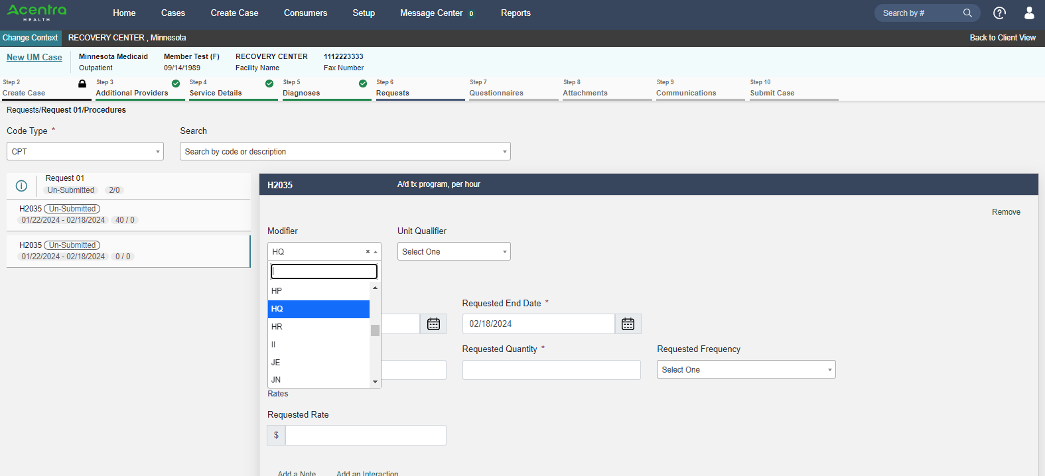
Portal Case Creation – Request 02 Procedure (if needed)
Only CPT Codes allowed:
Add all requests for an individual on one case.
Dates will copy from the first line
Quantity = how many extra units do you need?
Are you asking for extra units per day (over 6 hrs?) or per week (over 30 hrs?)
Click on “Validate Request” to continue
H2035 – Individual Treatment
H2035 HQ – Group Treatment
Notes:
Search for H2035 again to create a second line and add in the HQ modifier to indicate group treatment.
The dates will populate from the first line and so you won't have to enter that a second time.
The only thing you’ll want to do differently is to verify the number of units that you're requesting is correct for this code.

Slide 39
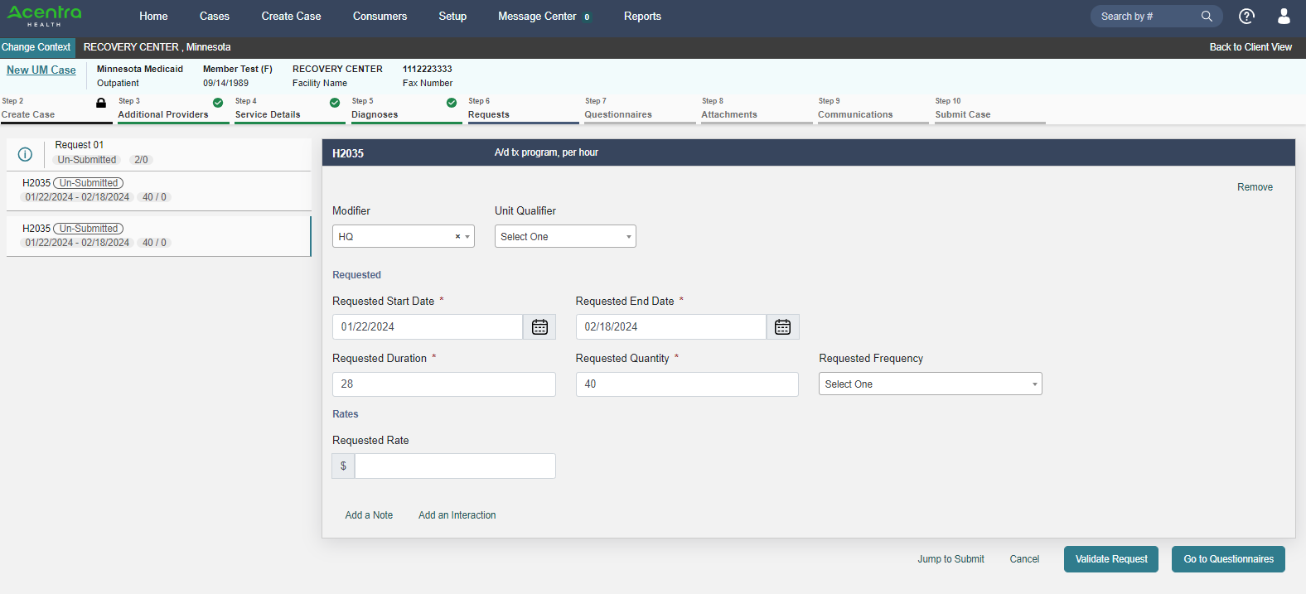
Portal Case Creation – Requests
Only CPT Codes allowed:
Both requests will populate on the left-hand side.
Review and verify the datespan and quantity are correct.
Click on “Go to Questionnaires” to continue
H2035 – Individual Treatment
H2035 HQ – Group Treatment
Notes:
Here you can see both individual and group treatment are listed. Double check the date span before proceeding.
Click “go to questionnaires” to continue.

Slide 40
Portal Case Creation – Questionnaires
Complete the Questionnaire
Click on the title of the Questionnaire, or
“Open” to complete the questionnaire.
Notes:
This is where the questionnaire that had those narrative questions that we talked about earlier can be found and completed.
After the questionnaire has been completed, you're going to go ahead and click on “Go to Attachments” to continue.

Slide 41
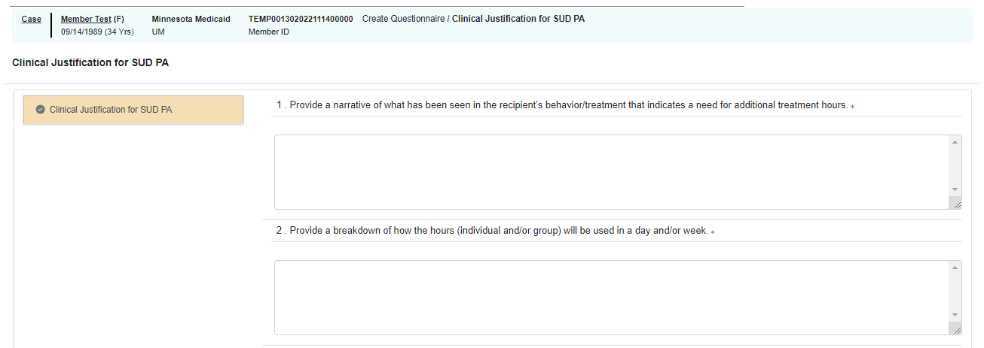
Portal Case Creation – Questionnaire Data Needed
Click “Mark as Complete”
This questionnaire must be completed to provide clinical justification for need of more than 6 hours of services/day or more than 30 hours of services/week.
Notes:
Reviewing the information needed in the questionnaire again is:
The narrative of what has been seen in the recipient’s behavior or treatment that indicates the need for additional treatment hours or units
The breakdown of how the hours are units will be used in a day or week,
How the clinician expects the extra services to benefit or assist the client in reaching their goals, and
The name and credentials of the licensed professional providing clinical justification.
Just a reminder that this questionnaire must be completed to provide clinical justification for the need of more than the six hours/units a day or 30 hours/units a week.
You will not be able to submit your case via the portal without this information.

Slide 42
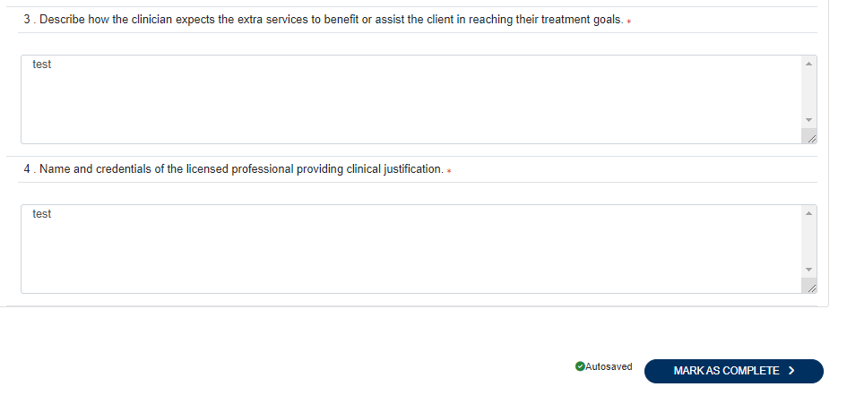
Portal Case Creation – Questionnaire Data Needed
Click
“Mark as Complete” to continue the case submission.
This questionnaire must be completed to provide clinical justification for need of more than 6 hours of services/day or more than 30 hours of services/week.
Notes:
Reviewing the information needed in the questionnaire again is:
The narrative of what has been seen in the recipient’s behavior or treatment that indicates the need for additional treatment hours or units
The breakdown of how the hours are units will be used in a day or week,
How the clinician expects the extra services to benefit or assist the client in reaching their goals, and
The name and credentials of the licensed professional providing clinical justification.
Just a reminder that this questionnaire must be completed to provide clinical justification for the need of more than the six hours/units a day or 30 hours/units a week.
You will not be able to submit your case via the portal without this information.

Slide 43
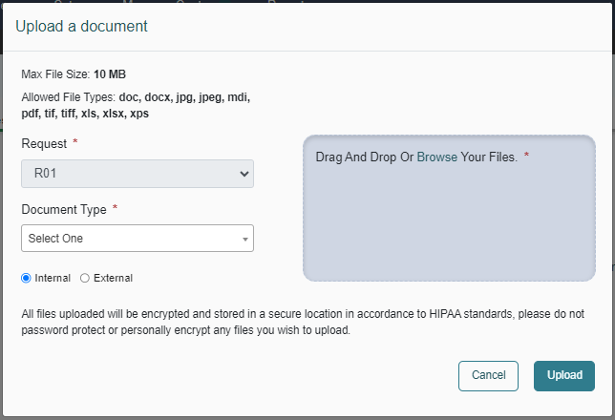
Portal Case Creation – Attachments
Click on “Upload a Document”
Notes:
To add documents, you have your typical drag and drop to add your files, or you can browse your files to add them here just like any other web based system. Click on “Upload” to upload the file.

Slide 44
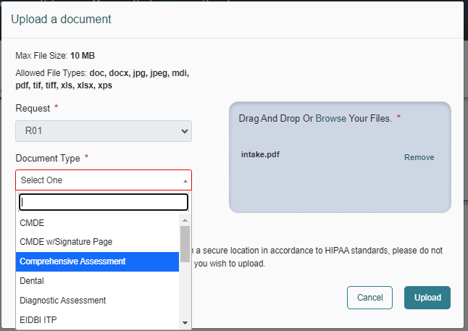
Portal Case Creation – Attachments
Drag and Drop or Browse for the Required Documents
Choose the correct “Document Type”
Click “Upload”
Required Documents
Current Comprehensive Assessment
Individual Treatment Plan
Progress notes, treatment plan reviews or integrated treatment plan reviews
Notes:
The required documents that you’ll need include:
comprehensive assessment
Individual treatment plan
Progress notes, treatment plan reviews, or integrated treatment plan reviews

Slide 45
Portal Case Creation – Attachments/Letters
No Attachments or Letters needed
Click “Go to Communications”
Notes:
There's no need for attachments or letters other than the documents you had already submitted, so you can click “go to communications.”

Slide 46
Portal Case Creation – Communications
9
No Communications
needed
Click “Go to Communications/Notes”
Notes:
The communications section is used to talk to the reviewers. In this circumstance, there shouldn't be a need for you to tell us anything in this section. Click “Go to Communications/Notes.”

Slide 47
Portal Case Creation – Communications/Notes
9
No Communications/Notes
needed
Click
“Go to Communications/Alerts”
Notes:
And then same with the communications. There’s nothing else needed here. You can click on “Go to communications/alerts”

Slide 48
Portal Case Creation – Communications/Alerts
9
No Communications/Alerts
needed
Click “Go to Submit”
Notes:
Nothing is needed here. And now you’ll click “Go to Submit”

Slide 49
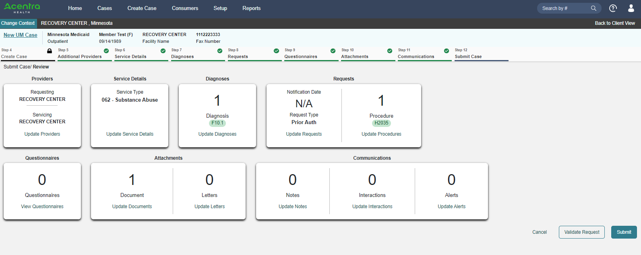
Submit Case/Review
10
This is a summary page of the case you are requesting.
Click “Submit” to submit the request.
Notes:
From the submit page, you'll see a summary of everything that you've entered. This is an opportunity to for you to verify that the information you've previously entered is accurate. Once you’ve verified the information click on “Submit”

Slide 50
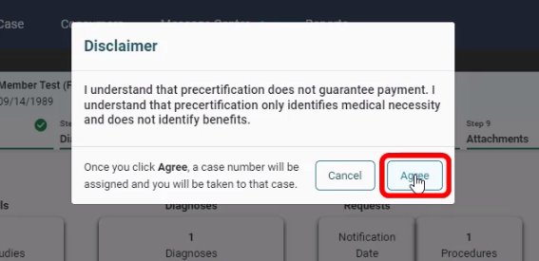
Submit Case/Attestation
10
Attest to the information that it being submitted.
Click “Agree”
Notes:
You'll receive a disclaimer/attestation that the PRECERTIFICATION does not guarantee payment. Click “agree” and the system will take you to the next screen where you will receive a case ID number.

Slide 51
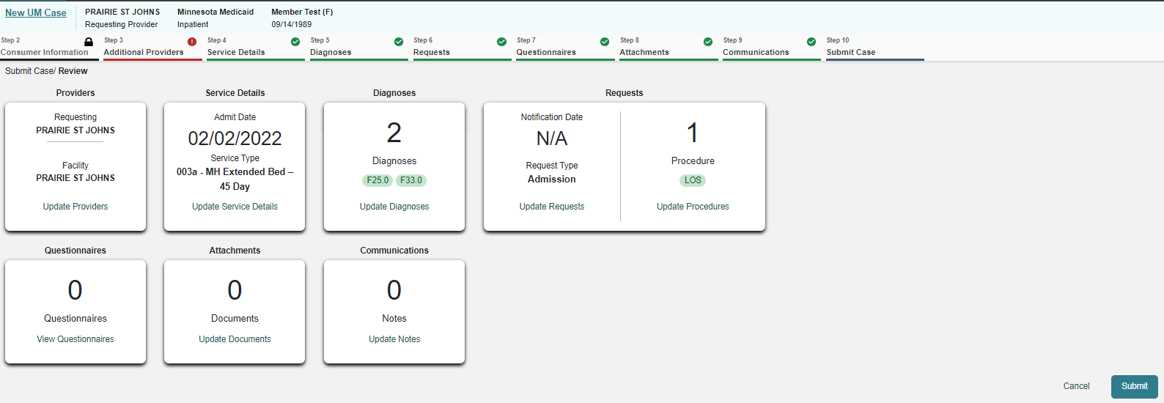
Submit Case
10
Suggestion to Provider: If you print or record this new Case ID number at this point, it will save you time tracking case status, monitoring for pended information or to enter questions/concerns to the Message system. You are able to search for submitted cases using this Case ID number via the Provider portal when required to EXTEND service lines to existing reviews.
Notes:
If you print or record this case ID, it's will save you time tracking the case status, monitoring for pended information, or entering questions and concerns to the message center in the future.
You can also search for your submitted cases using the case ID and for when you required to extend the service lines to the existing reviews and determining authorization status.

Slide 52
PART six
Determining the
Authorization status

Slide 53
Determining if an Authorization has been Approved
Once logged in, in the upper right hand corner you will see a “Search by #” field
Use the Case ID from when you submitted the case to quickly search for it.
Notes:
After you log into Atrezzo or the Provider Portal and you want to determine the authorization status of the review or what the authorization number is.
Opposite of where it says create a case is this little blue bar that says search by number.
This is where you would want to put in the case ID. You can also search by consumer on your homepage to show your existing cases.

Slide 54
Determining if an Authorization has been Approved
Notice that this case shows “Completed” in orange.
Under “SRV AUTH” you will see your prior authorization number for claims.
You may click on the “Case Summary” button to see the approval information.
You can also scroll down to “Service Details” to see the approval information.
Notes:
Here on the left hand side you will see that it says completed. Next to that is your case ID, then the category of service, the contract the case was submitted under, and the date you submitted the case. In the section to the right of the submitted date is going to be where your authorization number would be.
You can also click on “Case Summary” which is right here in the middle, or you can also Scroll down to service details which is right underneath this clinical section to see the approval information.
The approval information can be found under the services details tab.
If you just click the down arrow, it's going to come up and it's going to show you your CPT code.

Slide 55
Determining if an Authorization has been Approved
Approval information under the service details tab
Approval information on the Case Summary page
Notes:
It'll say H2035 and then H2035 HQ.
You’ll notice it says “Approved” in green. If the services are denied, it will say “denied” in red.
The service detail tab information will tell you how many units were approved out of the requested number of units. The service detail information will also tell you the date span that the approval is for.
If you choose to click on the case summary page, that page looks a little bit different.
Here is a comparison of how the two views look.
The case summary is like a snapshot of everything you submitted. You can print the case summary for your records if you want.
To clarify a couple of things that you may see:
The notification date is the date that you started the request.
And so you'll have two options to see the approved status of the cases.
As a reminder, that initial authorization is good for 28 days.
So what happens after that initial 28 days?
We’ll go over that next here (next slide) in how to extend a case.

Slide 56
PART seven
How to Extend a Case
(ask for additional units for authorization)
Notes:
Extending a case makes it easier for you because it duplicates everything you've already submitted. We’ll watch a quick video that walks you through it.

Slide 57
Notes:
☺

Slide 58
Authorization Resources
MHCP Substance Use Disorder (SUD) Services Provider Manual
Provider Manual Authorization Page
Authorization Forms
Enrolled 1115 Demonstration Providers:
MinnesotaASAM@Acentra.com
(for portal registration numbers)
MN Statute 245G
Acentra Customer Service: 866-433-3658
MNProviderIssues@kepro.com
(password resets, adding new users, system lock out issues)
MN Statute 254B.05

Slide 59
Acentra Provider Services: (866) 433-3658
MNProviderIssues@kepro.com (technical assistance)

